Slide 1

Neo bank
Digital Bank Management System
DAMG6210 : Final Project – Team 10
By : Arun Raja Yogidas Neha Sanaye Nikhil Sanaye
Raksha Kagadalu Raju
Uday Siddharth kadiyala Sai
This Photo by Unknown Author is licensed under CC BY-SA-NC

Slide 2
Database purpose
In traditional banks, customers are expected to visit the bank to perform various financial transactions and day-to-day banking needs. In these post-pandemic days of inflation, there is a strong need to reduce costs in all possible ways.
Also, in the traditional banking system, there would be multiple accounts to maintain and track every financial request such as loans, forex cards, and investments. Through our digital banking system, we aim to provide the customers with a one-stop solution for all their banking needs from the comfort of their homes from anywhere and anytime.

Slide 3

Business Problems Addressed
Remote Accessibility: Through digital banking, we can provide easy services to people living in rural areas to perform their daily banking needs.
Convenience: Customer can manage their account from the comfort of their homes and the digital banking system is available 24/7
Paperless records: All the transaction statements can be accessed online anytime and anywhere
Forex card services: Customers can place the forex card request digitally and track the status online. They can also load their forex card with the desired amount.
Investments: Customers can manage their investments such as bonds, stocks, and commodities directly through their bank accounts.
Loan Requests: Customers can request a loan from the bank instantly at the click of a button. They can also track the status of the request online which would be faster than the traditional

Slide 4
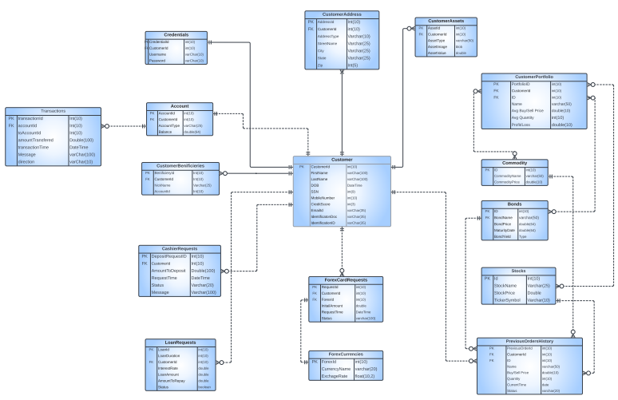
ERD

Slide 5
Steps for implementing of DB
Created all tables
Added column level and table level constraints (4)
Added data encryption for SSN and password
Created 15 different stored procedures
Inserted data into the DB using INSERT queries and stored procedures
Created views for both admin and customers
Exported the data into Tableau for data visualization
Created 9 different triggers.

Slide 6

Workflows
Customer can open a bank account
Customers can deposit money, add beneficiaries, and transfer money
Customers can request forex cards
Customers can apply for loans and repay their monthly installments
Customers can build their investment portfolio by investing in stocks, bonds, and commodities
Admins can create accounts for customer
Admins can approve all the requests, such as – cashier requests, loans, and forex requests
Admin can also update the prices of bonds, stocks, and commodities

Slide 7
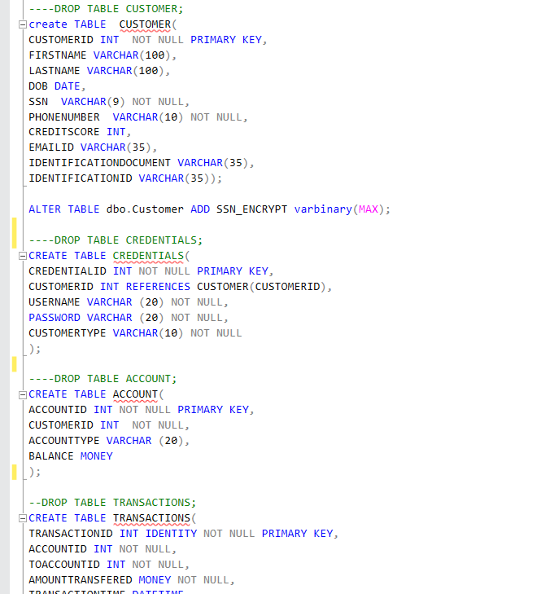
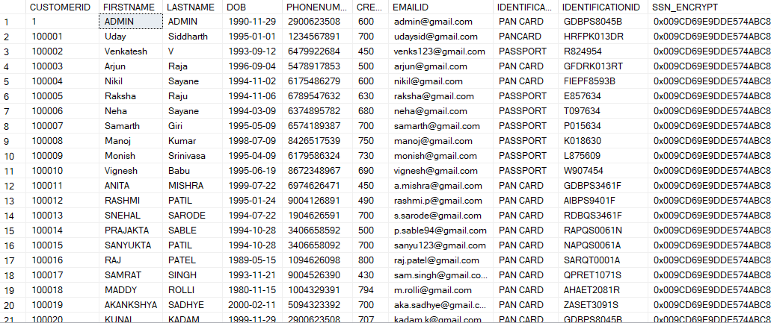
DDL Queries for Table Creation

Slide 8
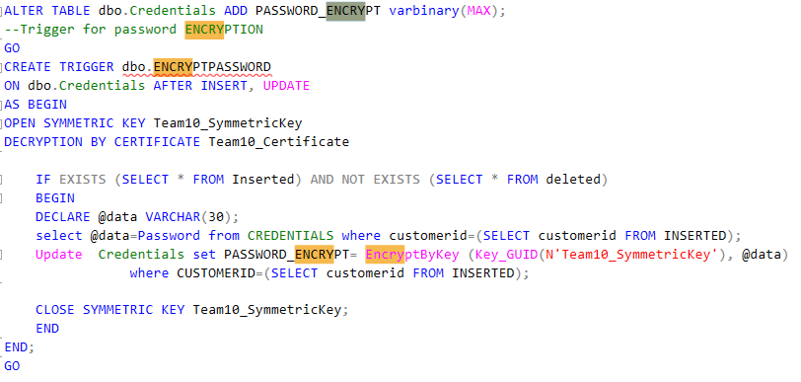
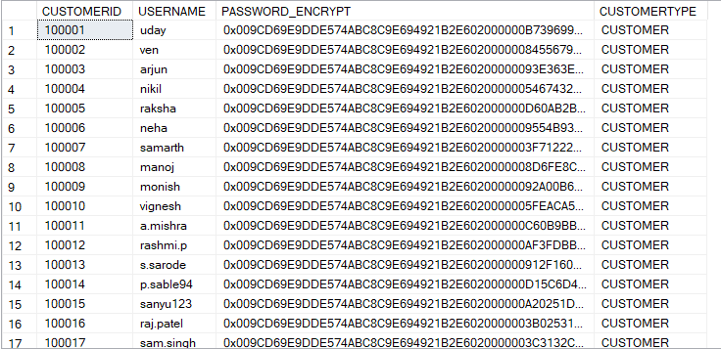
Password and SSN Encryption
To ensure that no one can access the SSN column, we encrypted it. With a symmetric key, only authorized users can access it.

Slide 9
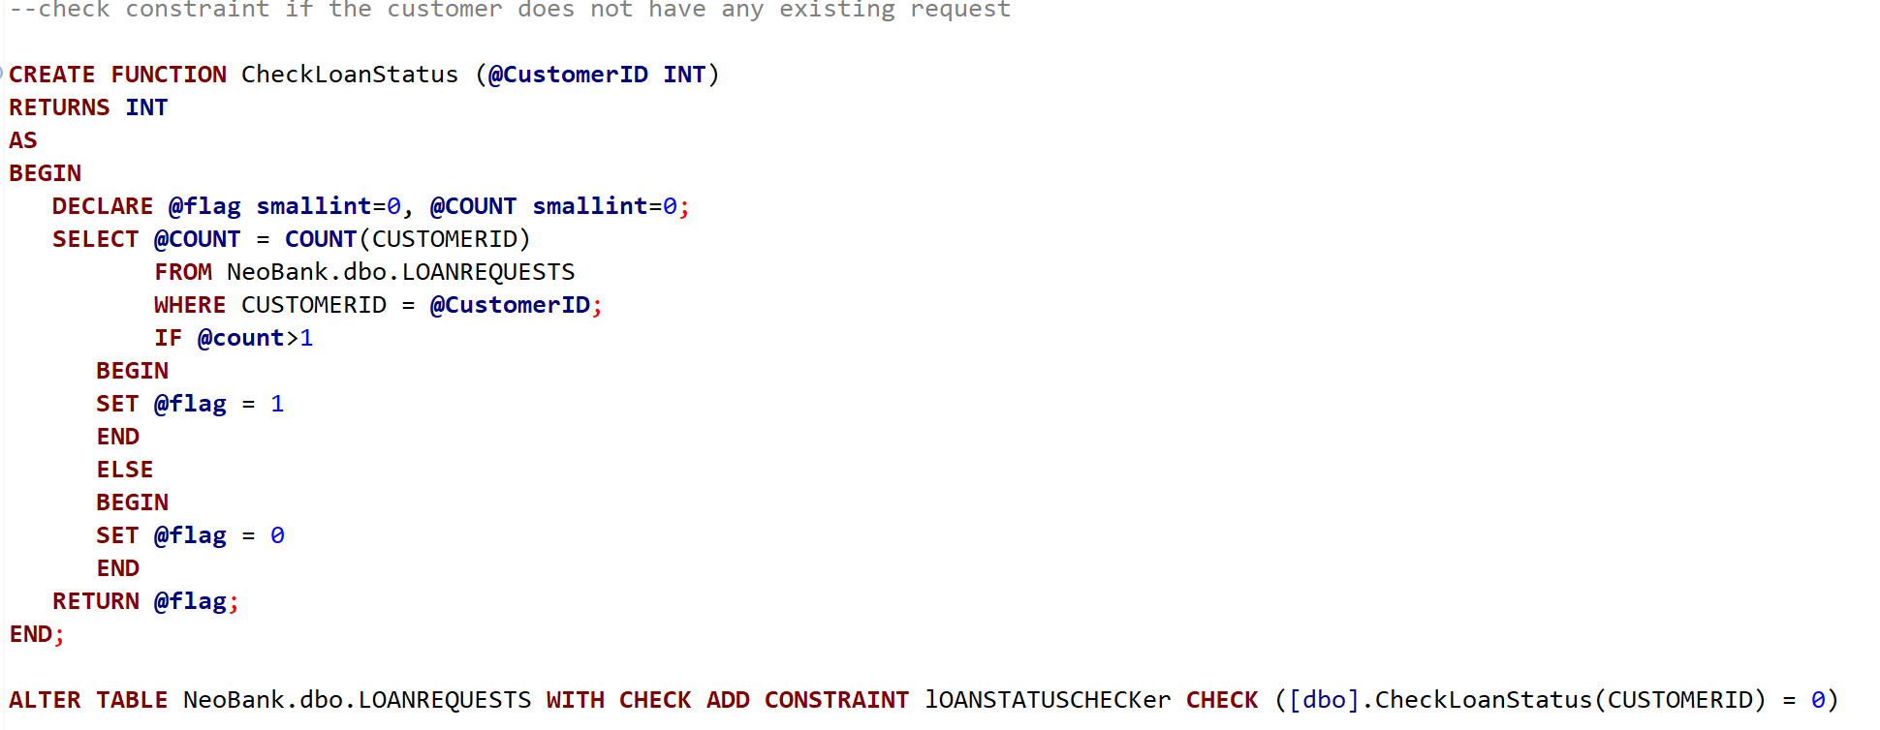
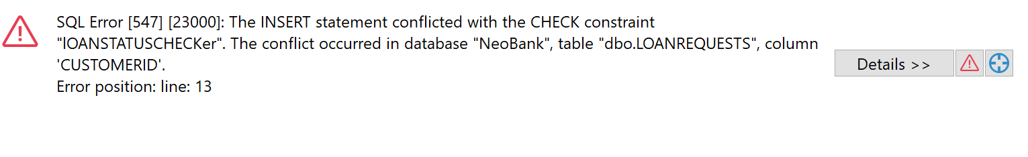
Table level constraints
To check if the customer has an existing loan

Slide 10

Other Table level constraints
To check if the beneficiary account exists in the database
Constraint to prevent multiple loan requests being made by the same customer
To check if the customer has a good credit score

Slide 11
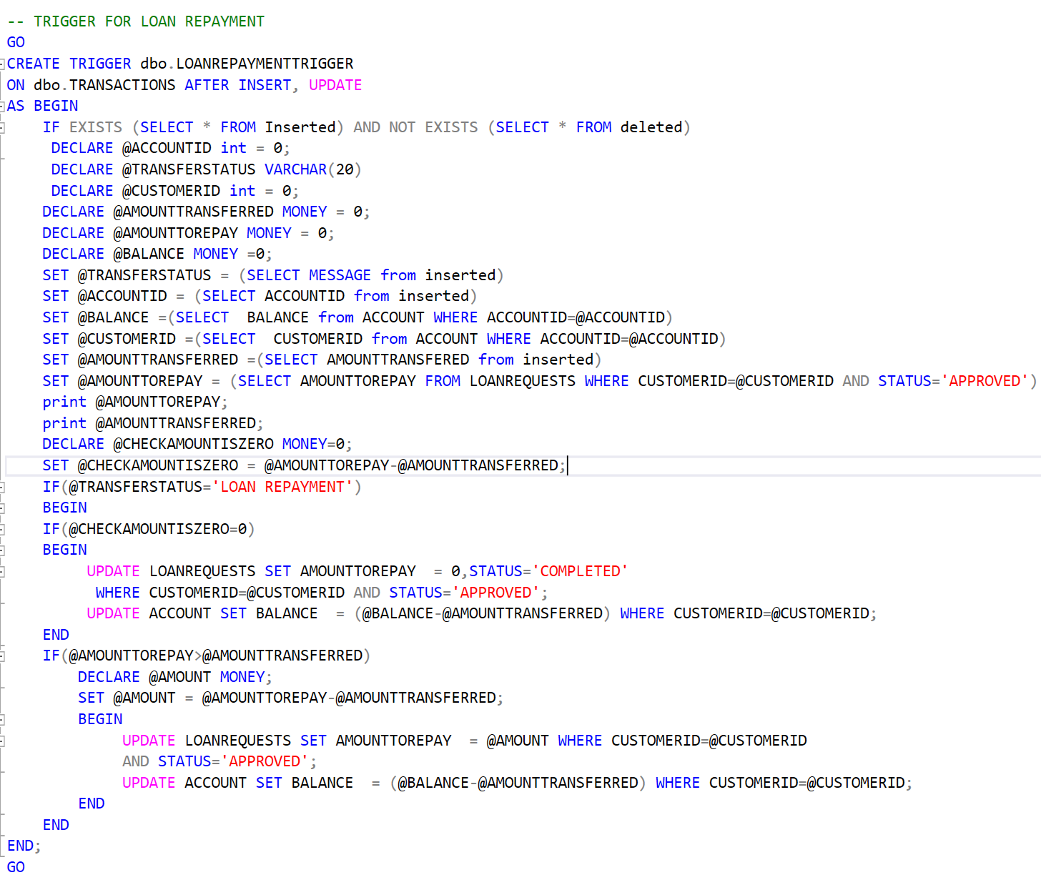
Triggers to handle loan repayment
It’s a trigger to accept any repayment of a disbursed loan
If the actual repayment amount is greater than the loan amount, then the transaction is rejected
This repayment is also updated in transactions table

Slide 12
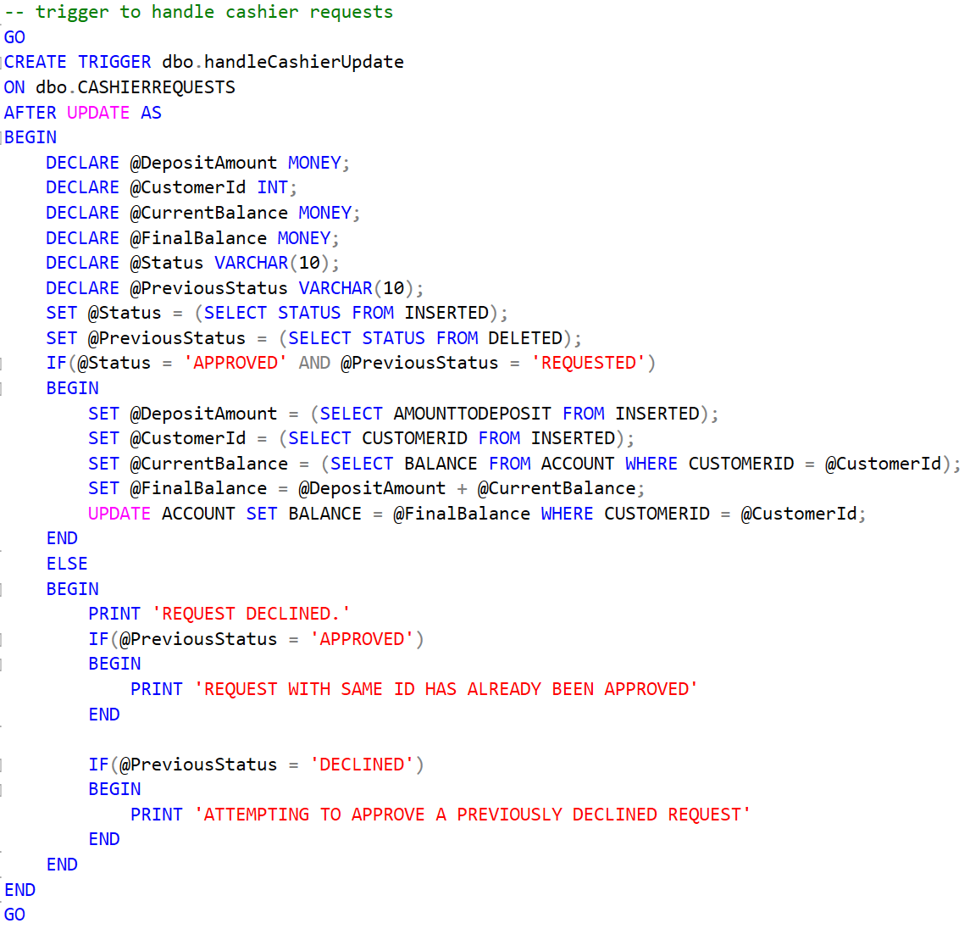
Trigger to handle cashier requests
To check if the previous state of the cashier request is valid
If it’s not valid, the cashier’s request will be declined
Else the money is transferred to the beneficiary account and deducted in the transfer’s account

Slide 13
Few of the other triggers :
To update the current commodity price in the portfolio
To update the current bonds price in the portfolio
To update the current stock price in the portfolio
To disburse loan amount upon approval
To validate input parameters in the customer table

Slide 14
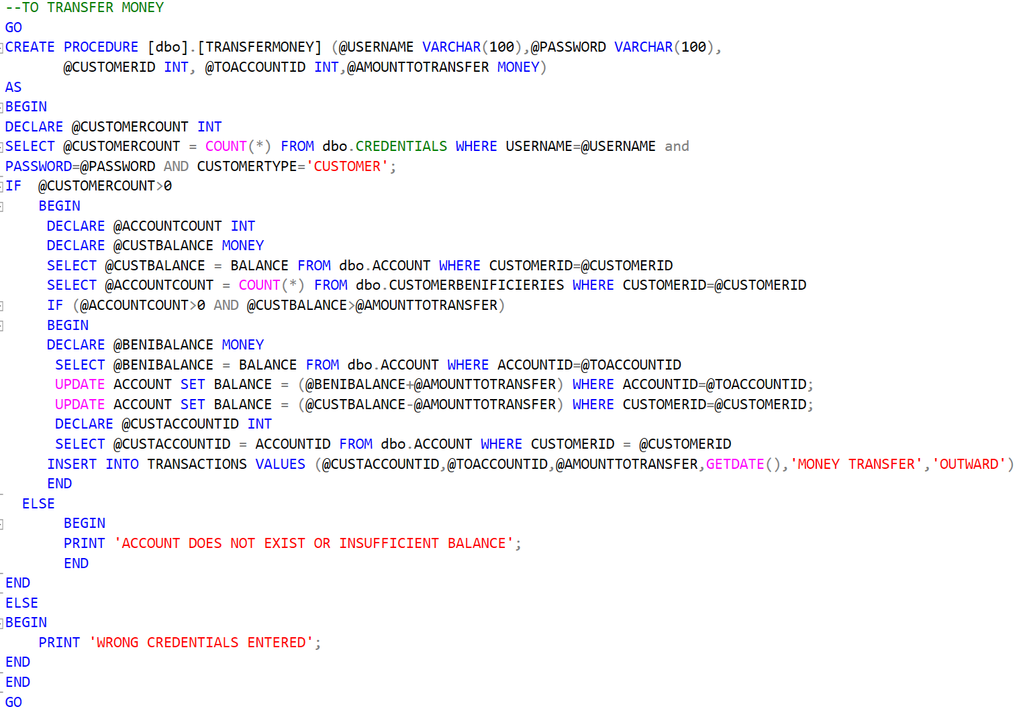
Stored Procedures
Check whether the beneficiary exists in the database , if the sender has the required money before transferring the money.

Slide 15
Other Stored Procedures
To execute buy or sell of commodity stocks or bonds. It checks if the person executing the trade has the required balance while buying an investment instrument
To check the eligibility status and approve forex requests
Stored procedures for inserting and updating stocks, bonds, and commodities
To add beneficiary and transfer money
To approve loan requests and the status of a loan

Slide 16
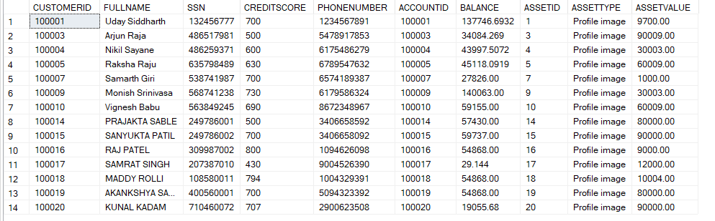
View -1
View used by loan officer to check the customer details
Tables Used :
Customer Table
Customer Assets
Accounts Table

Slide 17
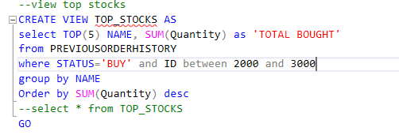
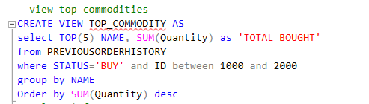
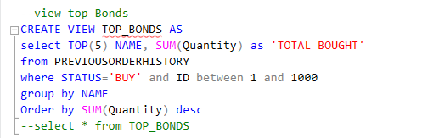
View -1I
View used by Customers or Investment Advisor to see the top selling investment options
Tables Used :
Previous Order History

Slide 18
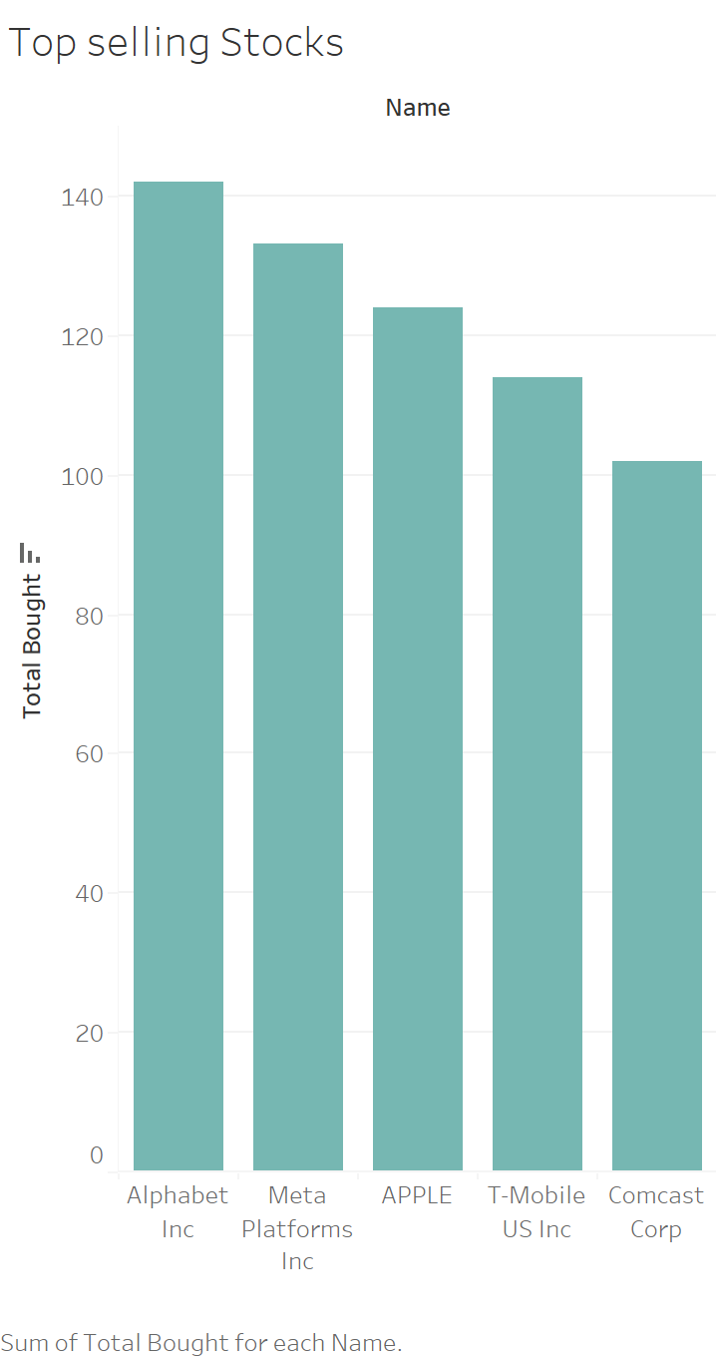
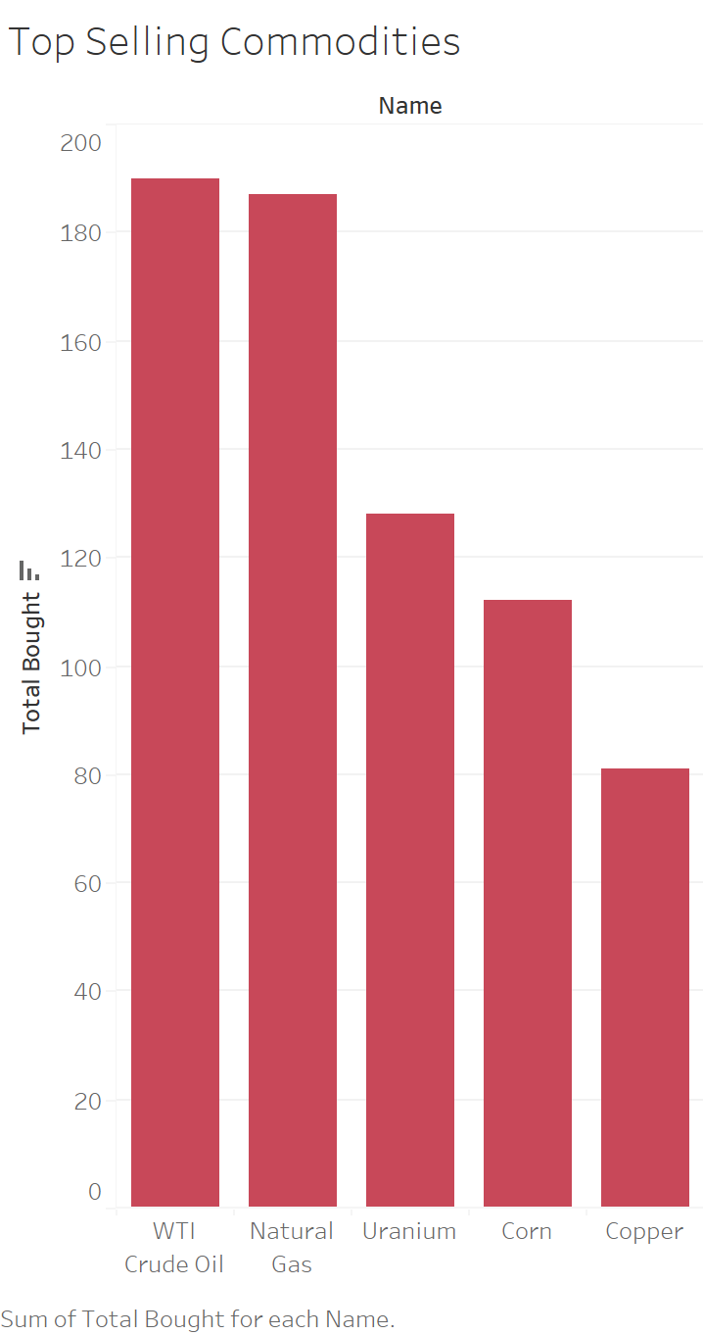
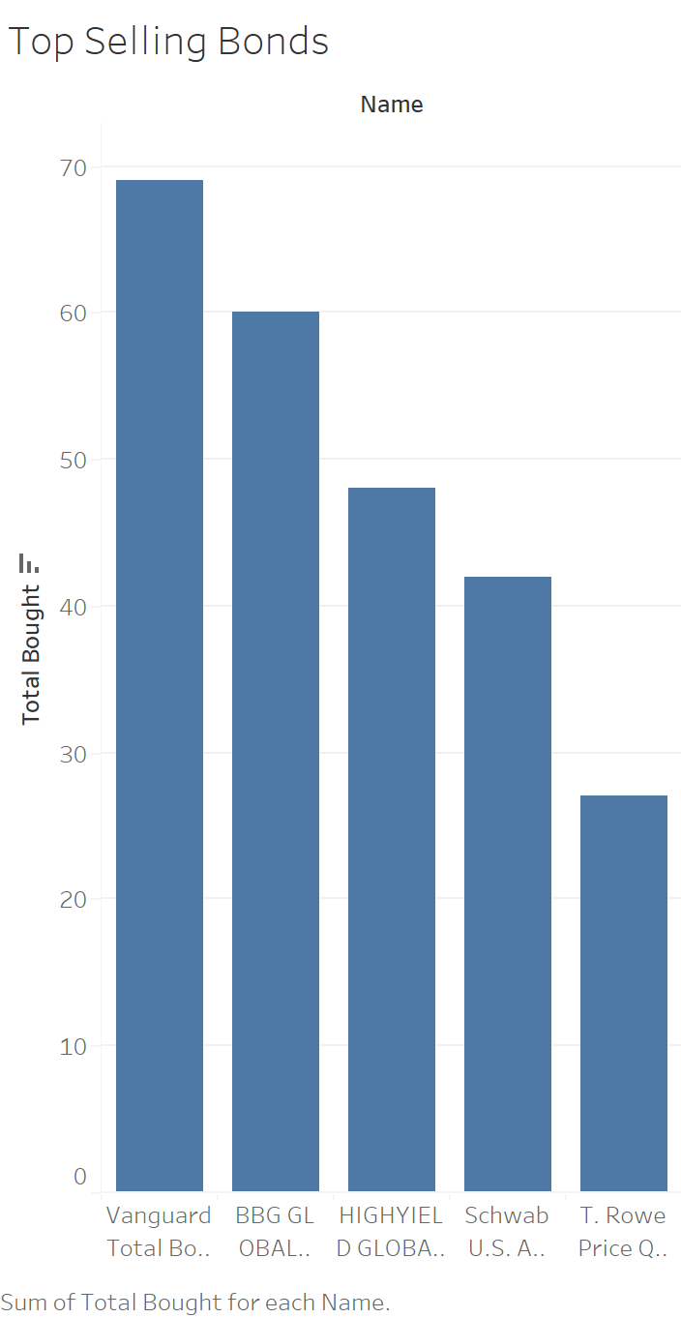
Analysis Using Tableau

Slide 19
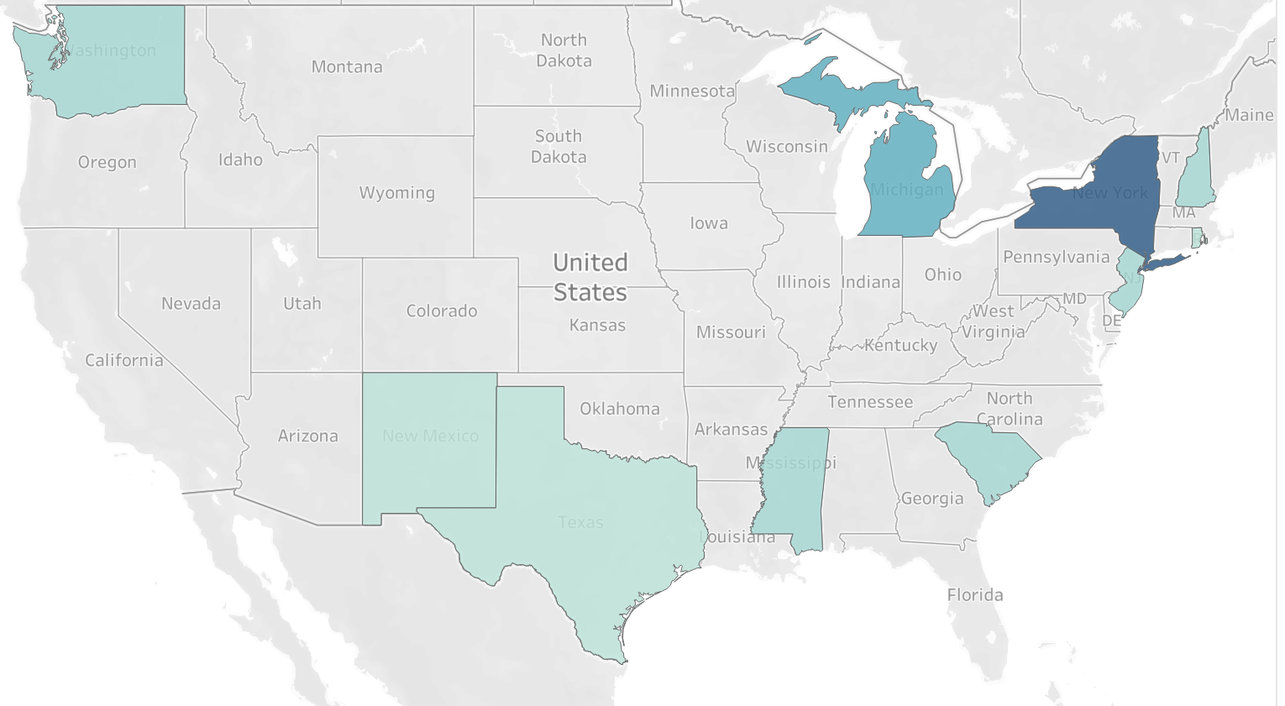
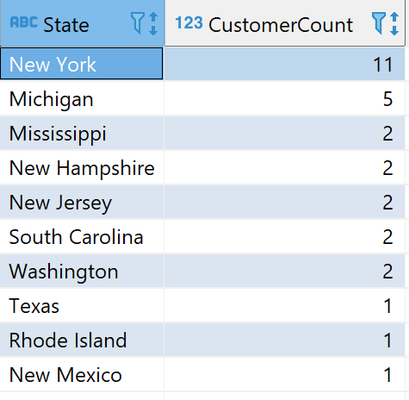
Analysis Using Tableau

Slide 20


Thank you

